Slide 1
Chapter 12
The Data Warehouse
Database Systems:
Design, Implementation, and Management, Sixth Edition, Rob and Coronel

Slide 2
Business Problems &
Data Analysis Needs
Operational databases served as the source of information to facilitate the decision making process
  Decision support systems (DSS) were developed around this data
Information requirements have grown quite complex over time and it is difficult to extract the all the needed information from a database

Slide 3
Business Problems &
Data Analysis Needs
The data warehouse provides a more comprehensive data pool by including not only operational data but data from external sources as well
The data warehouse also stores the data in structures that simplify information generation as well make it possible to generate a type and extent of data not otherwise available

Slide 4
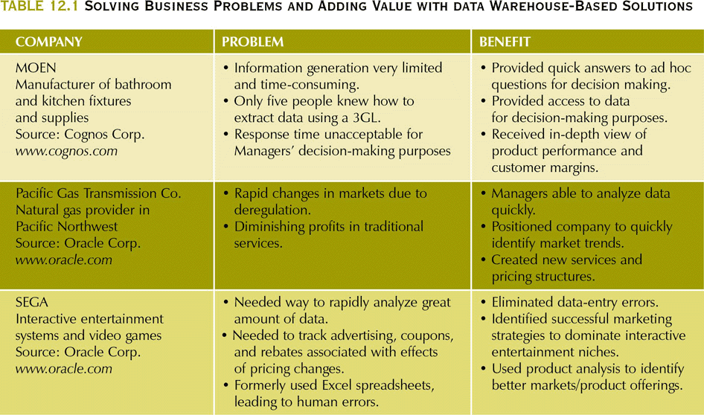
Solving Business Problems and Adding Value with Data Warehouse-Based Solutions

Slide 5
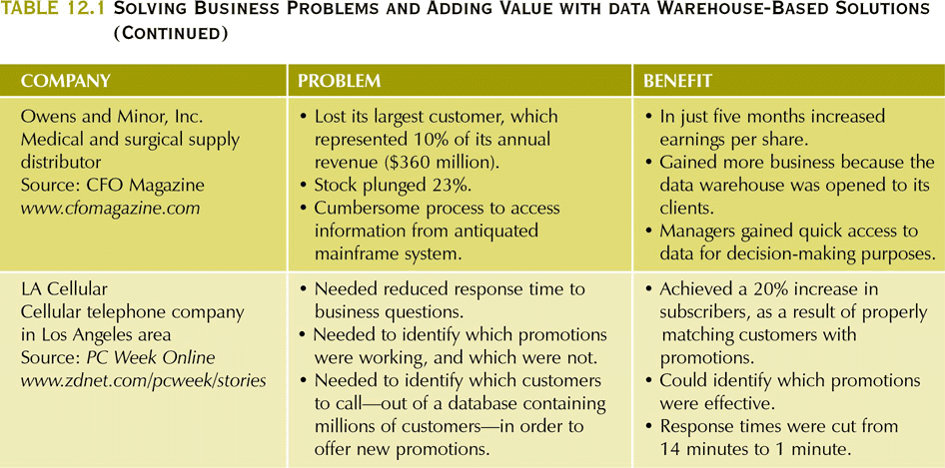
Solving Business Problems and Adding Value with Data Warehouse-Based Solutions

Slide 6
Decision Support Systems
Methodology (or series of methodologies) designed to extract information from data and to use such information as a basis for decision making
Decision support system (DSS):
  Arrangement of computerized tools used to assist managerial decision making within a business
  Usually requires extensive data “massaging” to produce information
  Used at all levels within an organization
  Often tailored to focus on specific business areas
  Provides ad hoc query tools to retrieve data and to display data in different formats

Slide 7
Decision Support Systems
Combines historical operational data with business models that reflect the business activities
  Compare the relative rates of productivity growth by company division over some specified period of time
  Define the relationship between advertising types and sales levels
  Define relative market shares by selected product lines

Slide 8
Decision Support Systems
Composed of four main components:
  Data store component
    Basically a DSS database containing business data and data model data coming from internal and external sources.
    Data is summarized and arranged in structures that are optimized for data analysis and query speed
  Data extraction and filtering component
    Used to extract and validate data taken from operational database and external data sources
  End-user query tool
    Used to create queries that access database
  End-user presentation tool
    Used to organize and present data

Slide 9
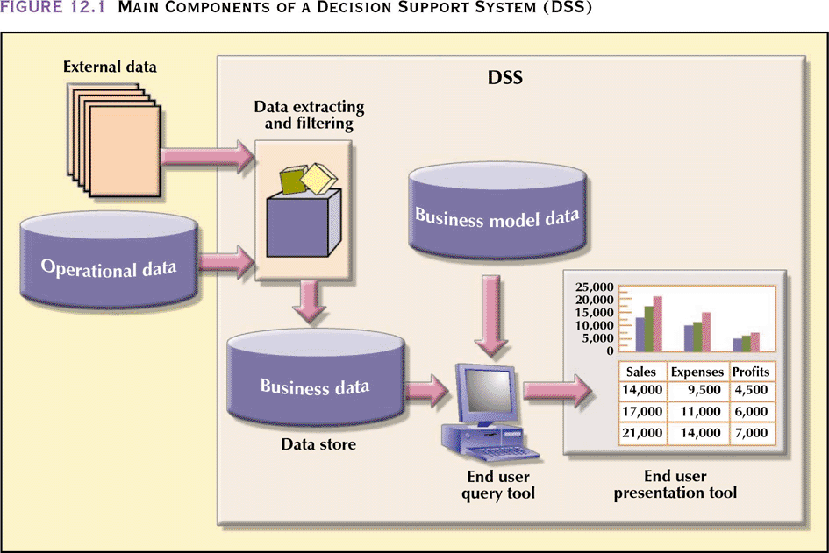
Main Components of a
Decision Support System (DSS)

Slide 10
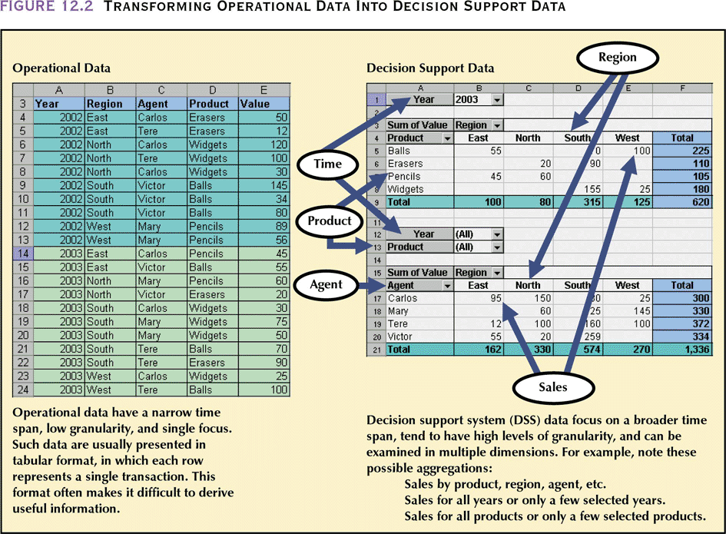
Transforming Operational Data Into Decision Support Data

Slide 11
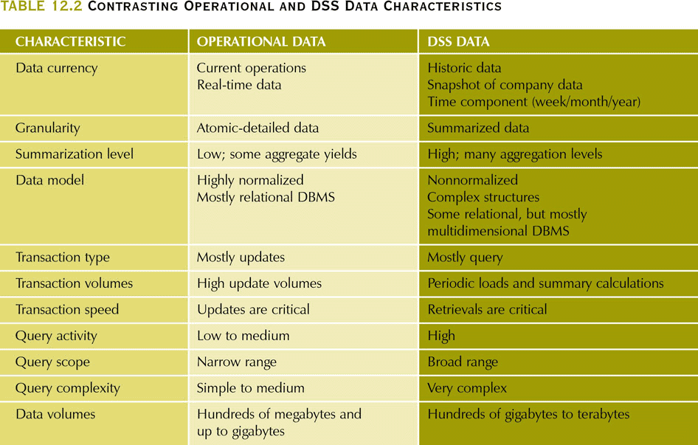
Contrasting Operational and DSS Data Characteristics

Slide 12
DSS Database Requirements
Database schema
  Must support complex (non-normalized) data representations
  Database must contain data that are aggregated and summarized and maintain relations with many other data elements
  Queries must be able to extract multidimensional time slices

Slide 13
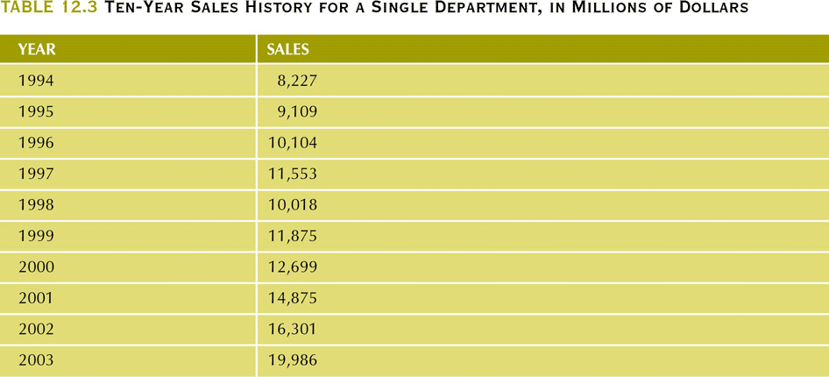
Ten-Year Sales History for a Single Department, in Millions of Dollars
10 year sales history for a single store containing a single department
  Data are fully normalized within the single table
Next slide shows yearly summaries of sales for two stores, each with two departments
  As number of years, stores and departments increase, redundancies increase and table may become non-normalized to speed up queries

Slide 14
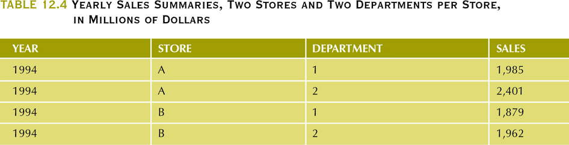
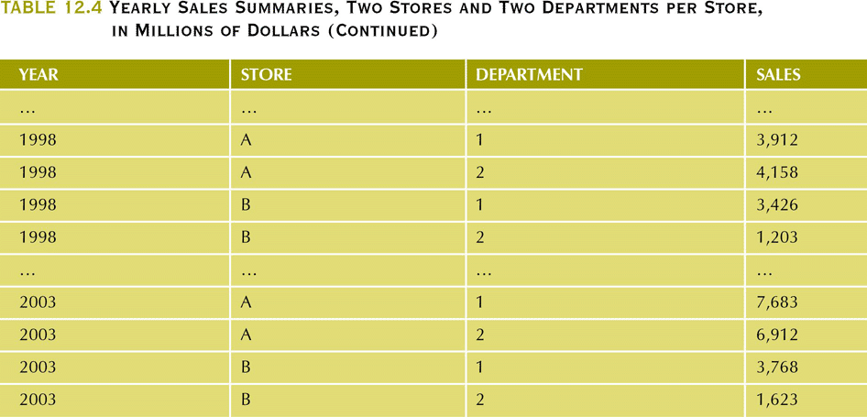
Yearly Sales Summaries, Two Stores and Two Departments per Store, In Millions of Dollars

Slide 15
DSS Database Requirements
Data extraction and loading
  DSS database is created largely by extracting data form the operational database and by importing additional data from external sources
  Thus, the DBMS must support advanced data extraction and filtering tools (batch and scheduled)
    Support different data sources – flat files, relational, multiple vendors
    Check for inconsistent data or data validation rules

Slide 16
DSS Database Requirements
End-user analytical interface
  DSS DBMS must support advanced data modeling and data presentation tools
    This makes it easier to define the business problem
    Once information retrieved, data analysis tools can be used to evaluate the query results
Database size
  Must be capable of supporting very large databases (VLDBs)
    Employ multiple disk arrays and multi-processor technologies such as symmetric MP or massively parallel processors

Slide 17
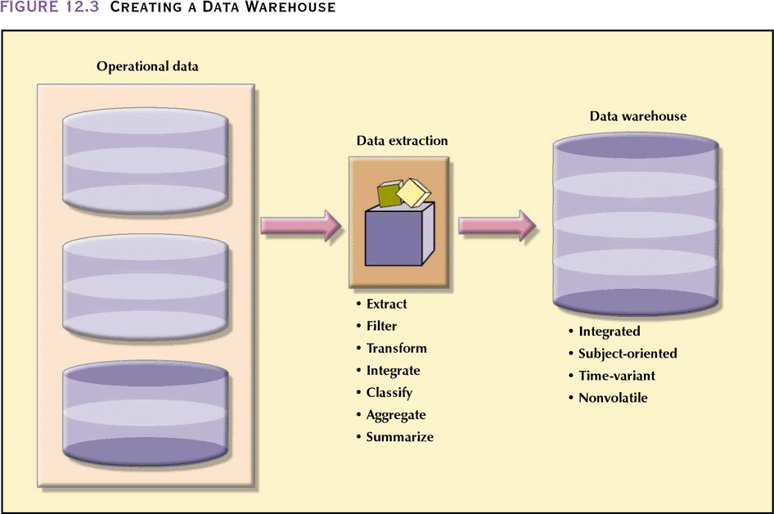
The Data Warehouse
Bill Inmon, father of the data warehouse, defines it as an integrated, subject-oriented, time-variant, nonvolatile database that provides support for decision making
Usually a read-only database optimized for data analysis and query processing

Slide 18
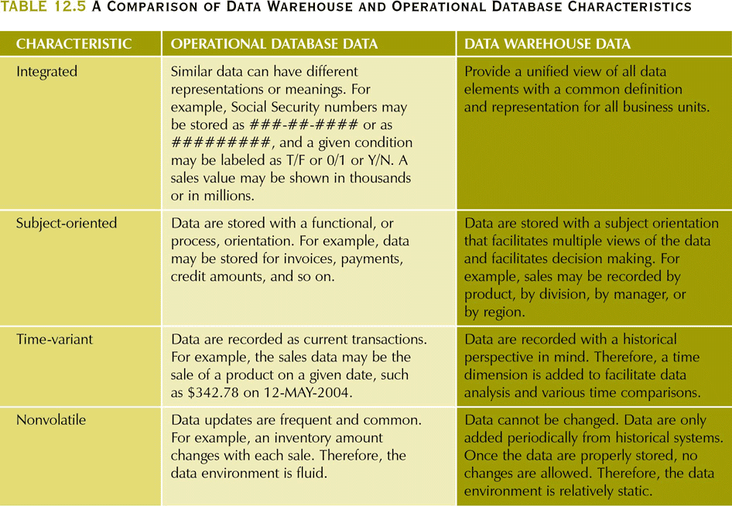
A Comparison of Data Warehouse and Operational Database Characteristics

Slide 19
The Data Mart
Because of the time, money and considerable mangerial effort required to create a data warehouse, many companies begin on a smaller scale with a data mart
A data mart is a small, single-subject data warehouse subset that provides decision support to a small group of people
  Lower cost, shorter implementation time
  Data marts can be customized to small groups in ways a centralized data warehouse can not
  Company culture may be to go slow with big changes, data mart is not as threatening
  Benefits can be determined based on experience which can give a justification to expand its use

Slide 20
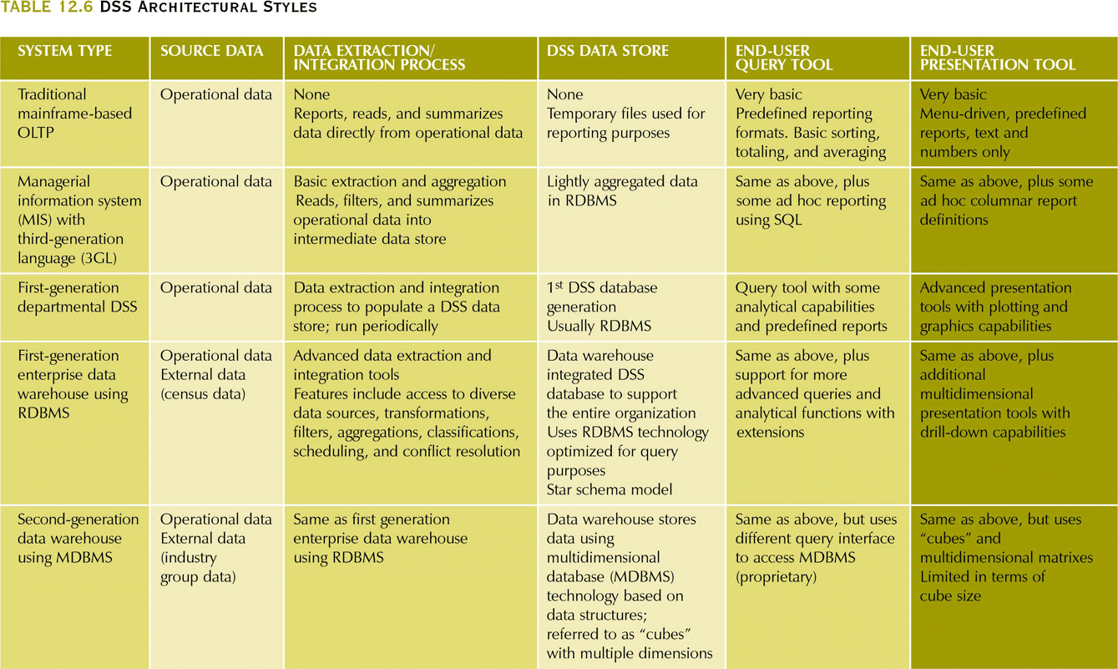
Summary of DSS Architectural Styles

Slide 21
12 Rules of a Data Warehouse
Inmon, Bill and Kelley, Chuck, “The Twelve Rules of Data Warehouse for a Client/Server World”, Data Management Review, 4(5), May 1994, pp 6-16.
Data Warehouse and Operational Environments are Separated
Data is integrated
Contains historical data over a long period of time
Data is a snapshot data captured at a given point in time
Data is subject-oriented

Slide 22
12 Rules of Data Warehouse
Mainly read-only with periodic batch updates
Development Life Cycle has a data driven approach versus the traditional process-driven approach
Data contains several levels of detail
  Current, Old, Lightly Summarized, Highly Summarized

Slide 23
Online Analytical Processing
Advanced data analysis environment that supports decision making, business modeling, and operations research
OLAP systems share four main characteristics:
  Use multidimensional data analysis techniques
  Provide advanced database support
  Provide easy-to-use end-user interfaces
  Support client/server architecture

Slide 24
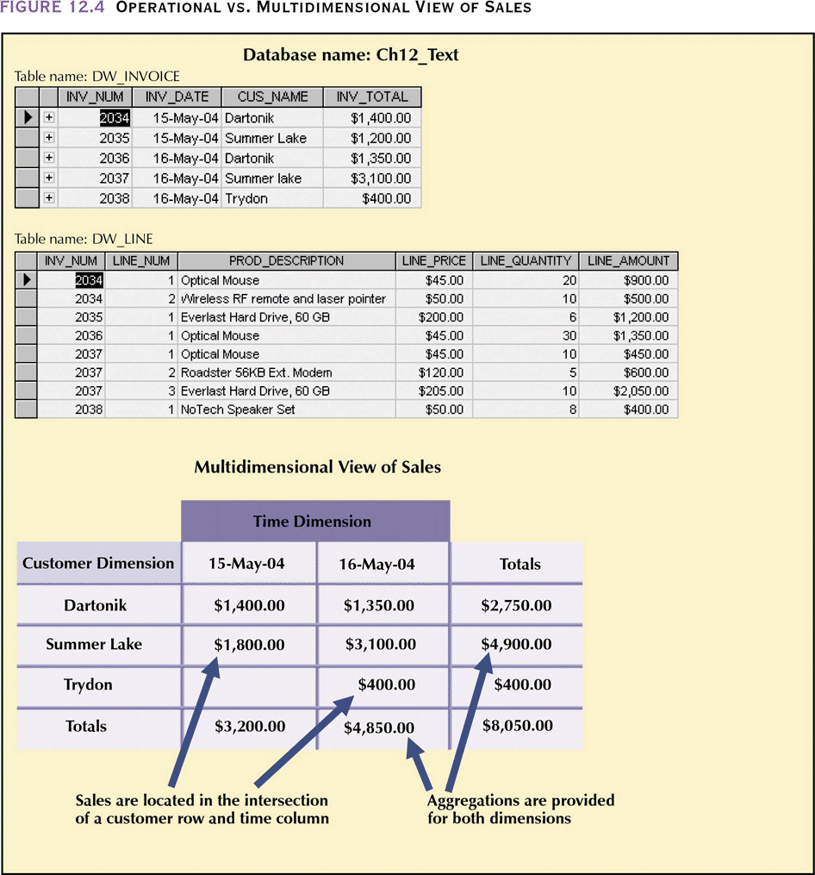
Operational vs. Multidimensional
View of Sales
View business data as data that are related to other business data e.g., sales data as related to customers and time

Slide 25
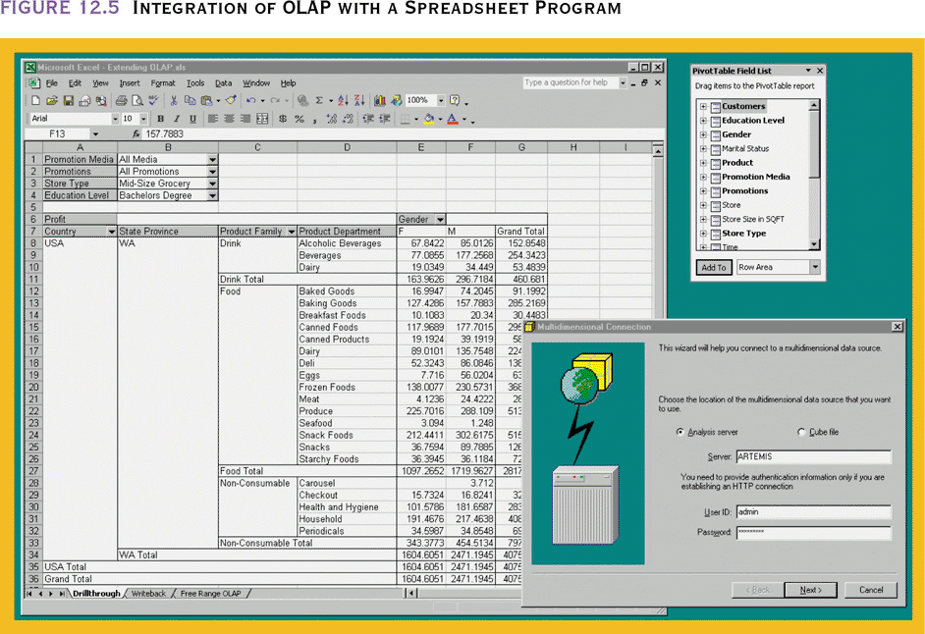
Integration of OLAP with a Spreadsheet Program
Most OLAP vendors have closely integrated their systems with desktop spreadsheets to take advantage of the analysis and presentation functionality of the spreadsheets that users are already familiar with

Slide 26
Advanced Database Support
To deliver efficient decision support, OLAP tools must have advanced data access features such as:
  Access to many different kinds of DBMSs, flat files, internal and external data sources
  Access to aggregated data warehouse data as well as detail data found in operational databases
  Advanced data navigation – drill-down and roll-up
  Support for VLDBs
  Rapid and consistent query response times

Slide 27
Client-Server Architecture
The C/S environment enables us to divide an OLAP system into several components that define its architecture
  These components can then be placed on the same computer or distributed among several computers
OLAP modules
  GUI
  Analytical processing logic
  Data processing logic

Slide 28
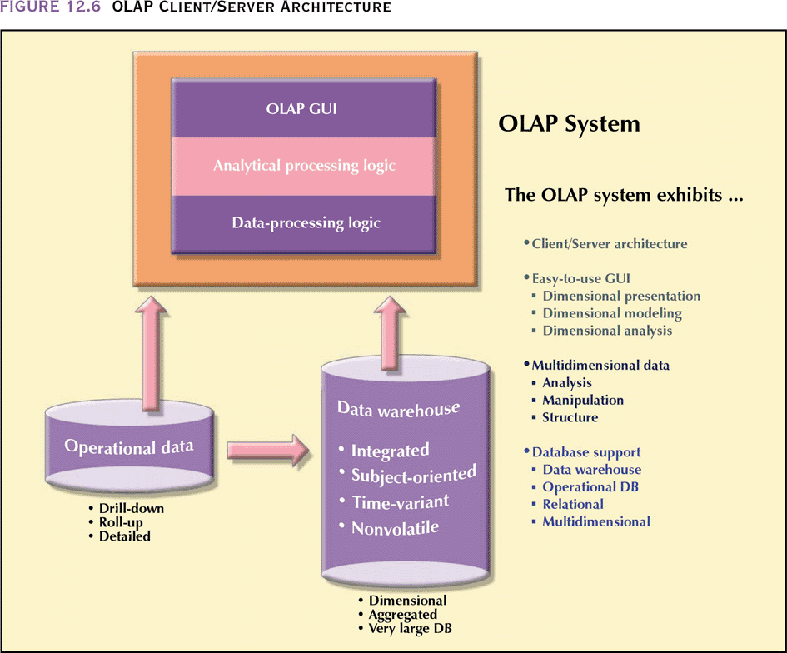
OLAP Client/Server Architecture
In this scenario, each analyst requires a powerful computer to store the OLAP system and perform all data processing locally. Also, each analyst uses a separate copy of the data – islands of information problem

Slide 29
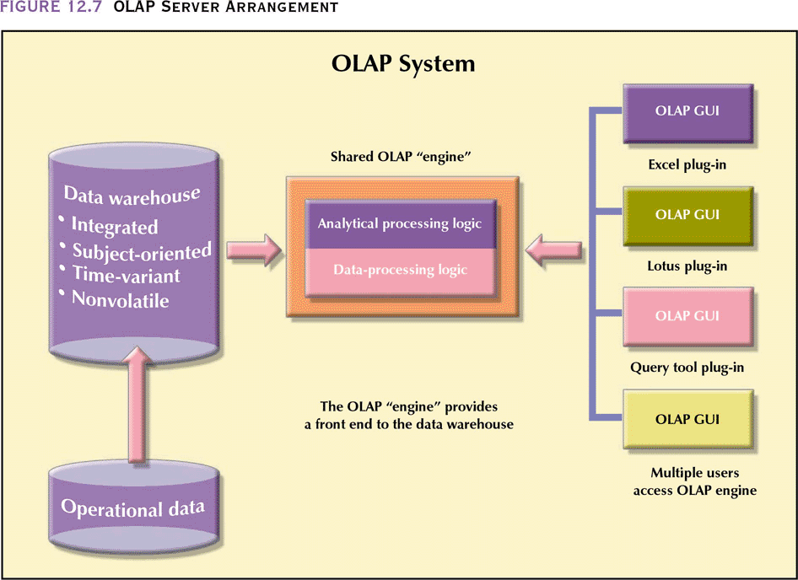
OLAP Server Arrangement
Here, the OLAP GUI runs on client workstations while the OLAP engine runs on a shared computer. The engine serves as the front-end to the data warehouse’s decision support data. OLAP and the data warehouse are independent pieces of the system.

Slide 30
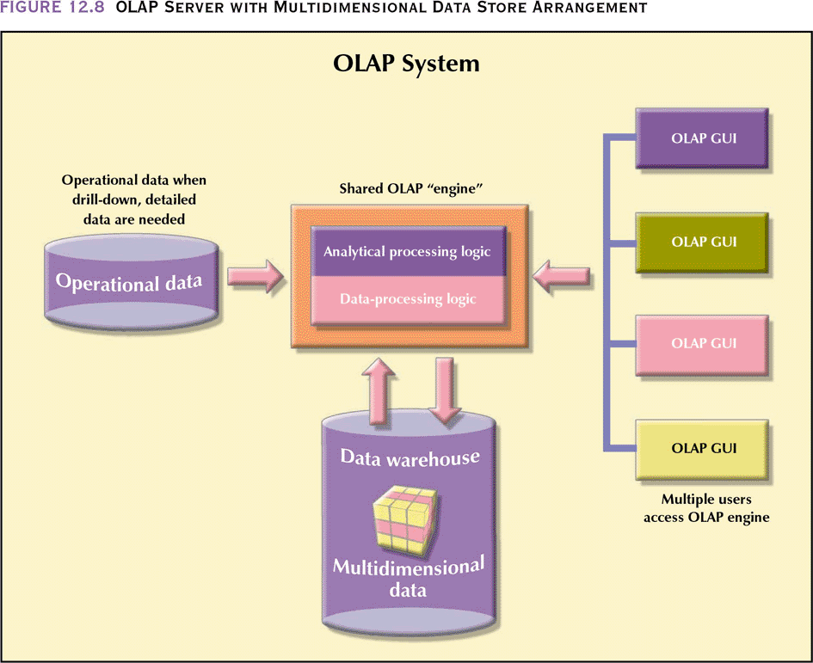
OLAP Server with Multidimensional Data Store Arrangement
In most implementations, the data warehouse and OLAP are interrelated and complementary environments. Here, the OLAP engine extracts data from the operational db and stores it in a multidimensional structure for further analysis

Slide 31
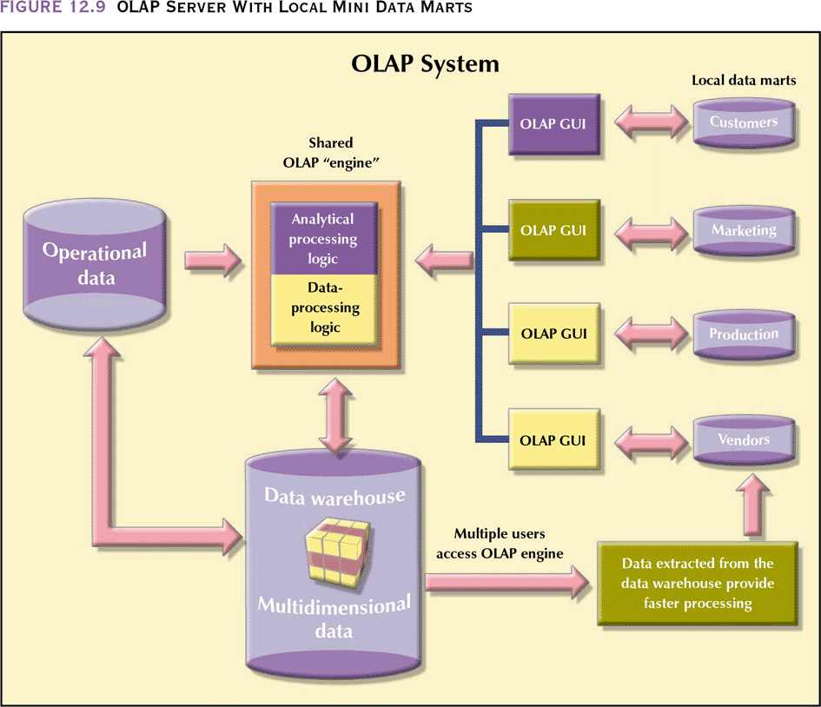
OLAP Server With Local Mini Data Marts
To provide better performance, some OLAP systems store small extracts of the data warehouse at end-user workstations. This increases the speed of data access and data visualization. Assumes that most end-users work with fairly small, stable data warehouse data subsets.

Slide 32
Relational OLAP
Builds on existing relational technologies
Adds the following extensions to RDBMS
  Multidimensional data schema support within the RDBMS
    Star schema to enable RDMS (normalized data) to support multidimensional data representations (nonnormalized, aggregated and duplicated)
  Data access language and query performance are optimized for multidimensional data
    ROLAP extends SQL so that it can differentiate between access requirements for data warehouse data and operational data
  Support for VLDBs

Slide 33
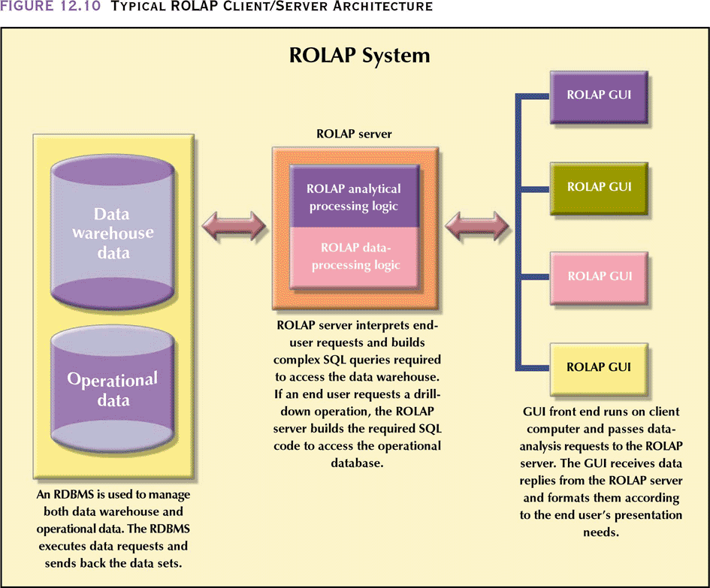
Typical ROLAP Client/Server Architecture

Slide 34
Multidimensional OLAP
MOLAP extends OLAP functionality to multidimensional DBMSs (MDBMSs)
  An MDBMS stores data in matrix-like n-dimensional arrays
  MDBMS end users visualize the stored data as a three-dimensional cube known as a data cube
    They data cubes can grow to n-dimensions becoming hypercubes
    Data cubes are created by extracting data from the operational databases or the data warehouse
    They are pre-created and static and queried based on their dimensions e.g., product, location and time for a cube for sales
    To speed data access they are held in memory – cube cache

Slide 35
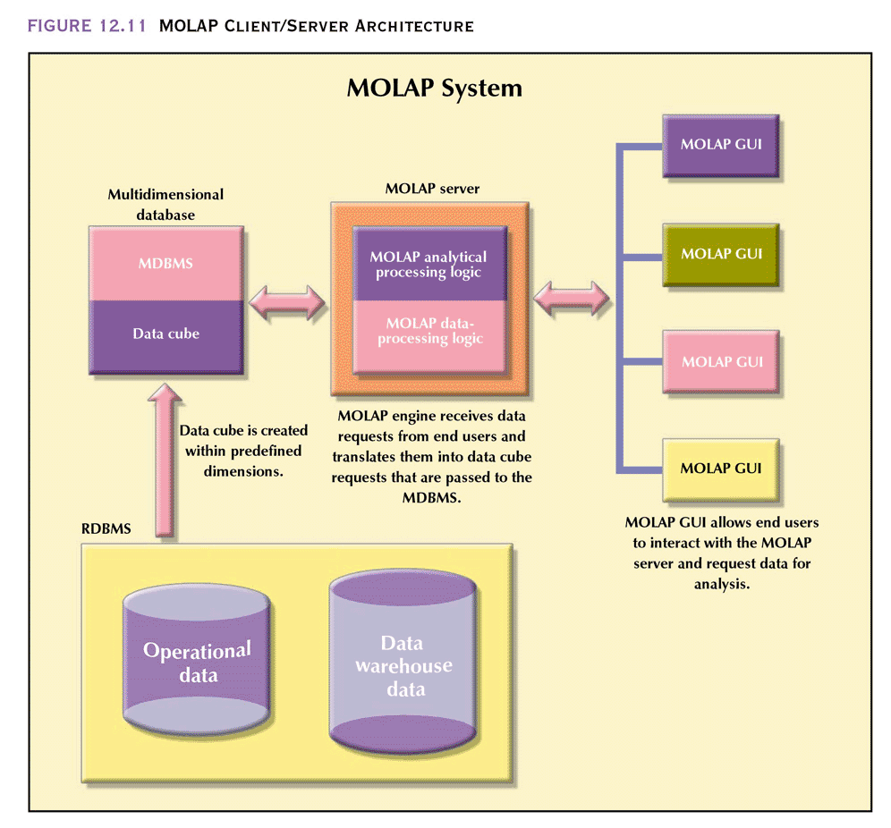
MOLAP Client/Server Architecture

Slide 36
MDBMS
Because a cube is pre-defined, the addition of a new dimension requires that the entire data cube be recreated – a time consuming process
  If this needs to be done often, the MDBMS loses some of its speed advantage over the RDBMS
  MDBMS is best suited for small and medium data sets
  Scalability is limited due to the restrictions on the size of the data cube to avoid lengthy data access times caused by having less memory available for the OS and application programs
  Employ proprietary data storage techniques that require proprietary data access methods using a multidimensional query language
  Most handle sparsity of the data cubes effectively to reduce processing overhead and resource requirements

Slide 37
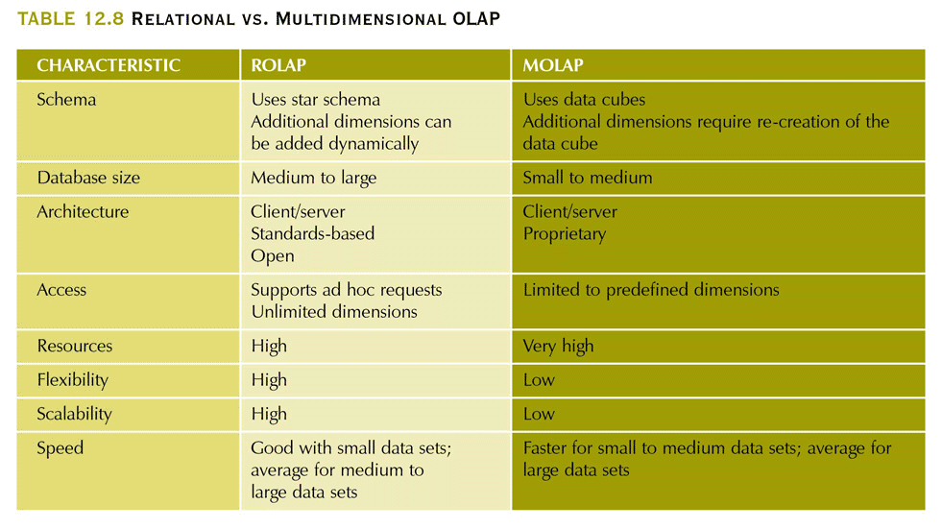
Relational vs. Multidimensional OLAP

Slide 38
Star Schemas
Data modeling technique used to map multidimensional decision support data into a relational database
  Creates the near equivalent of a multidimensional database schema from the existing relational database
  The schema was developed because existing relational modeling techniques, ER and normalization did not yield a database structure that served advanced data analysis requirements well
Yield an easily implemented model for multidimensional data analysis, while still preserving the relational structures on which the operational database is built
Has four components: facts, dimensions, attributes, and attribute hierarchies

Slide 39
Star Schemas
Facts: numeric values that represent a specific business aspect or activity (sales figures).
  The fact table contains facts that ate linked through their dimensions (see below)
  Metrics are facts computed or derived at run time
Dimensions: qualifying characteristics that provide additional perspectives to a fact (sales have product, location and time dimensions)
  Dimensions are stored in a dimension table

Slide 40
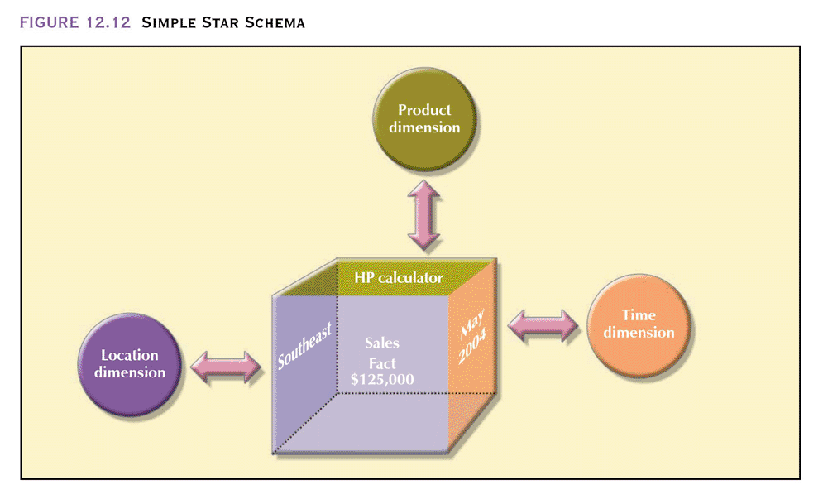
Star Schema for Sales with Dimensions

Slide 41
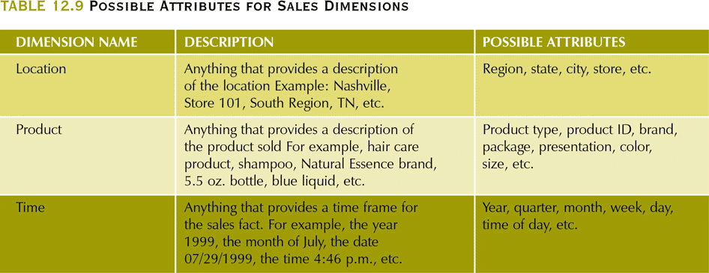
Star Schemas
Attributes: Each dimension table contains attributes often used to search, filter or classify facts
  Dimensions provide descriptive characteristics about the facts through their attributes

Slide 42
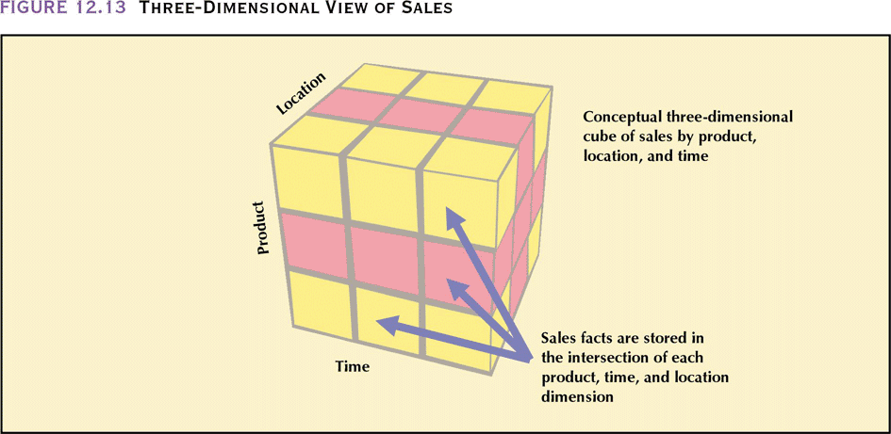
Star Schemas
We can logically view the multidimensional data model as an n-dimensional cube
  The sales data can be viewed in 3 dimensiosns – product, location and time

Slide 43
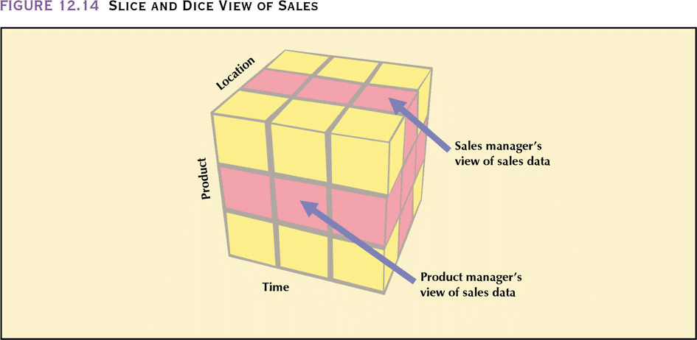
Slice and Dice View of Sales
This gives us the ability to focus on specific “slices” of the cube
  Product manager studies the sales of a product
  Store manager studies sales by store
  The ability to focus on slices of a cube to perform a more detailed analysis is known as “slice and dice”
    Intersecting slices produce small cubes – the dice

Slide 44
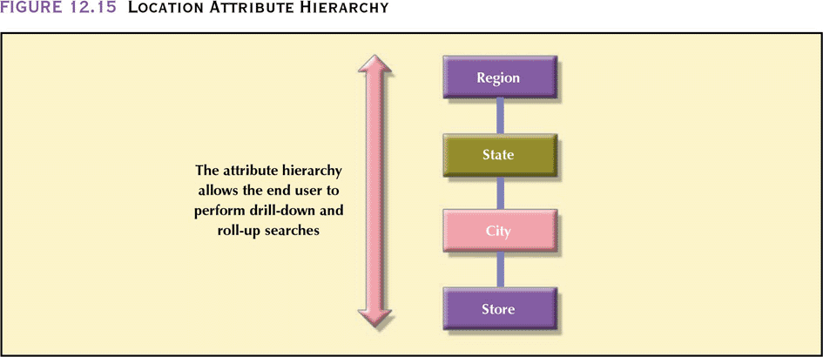
Location Attribute Hierarchy

Slide 45
Attribute Hierarchies
Attributes within dimensions can be ordered in a well-defined attribute hierarchy
The attribute hierarchy provides a top-down data organization that can be used for
    Aggregation
    Drill-down/roll-up data analysis

Slide 46
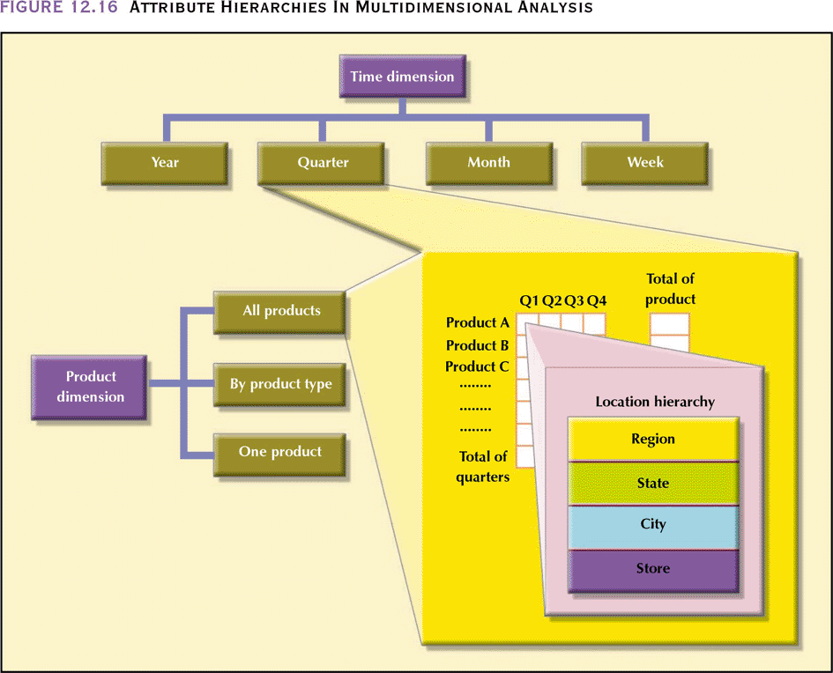
Attribute Hierarchies In
Multidimensional Analysis
Product can be viewed overall, by product type or by individual product
Time can be as detailed as a week or aggregated up to year
Location can be as specific as store or rolled up to city then state then region

Slide 47
Star Schema Representation
Facts and dimensions are normally represented by physical tables in the data warehouse database
The fact table is related to each dimension table in a many to one relationship
  Many fact rows are related to each dimension row – each product appears many times in the sales fact table
Fact and dimension tables are related by foreign keys and are subject to the familiar PK/FK constraints
  Because the fact table is related to many dimension tables, the PK of the fact table is a composite PK

Slide 48
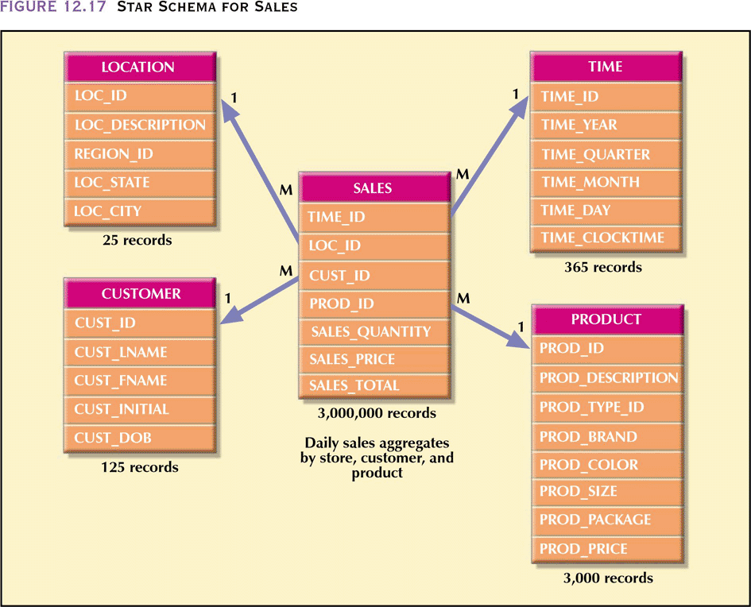
Star Schema for Sales

Slide 49
Implementing a Data Warehouse
Numerous constraints:
  Available funding
  Management’s view of the role played by an IS department and of the extent and depth of the information requirements
  Corporate culture
No single formula can describe perfect data warehouse development

Slide 50
Factors Common to Data Warehousing
Data warehouse is not a static database
Dynamic framework for decision support that is always a work in progress
Data warehouse data cross departmental lines and geographical boundaries
Must satisfy:
  Data integration and loading criteria
  Data analysis capabilities with acceptable query performance
  End-user data analysis needs
Apply database design procedures

Slide 51
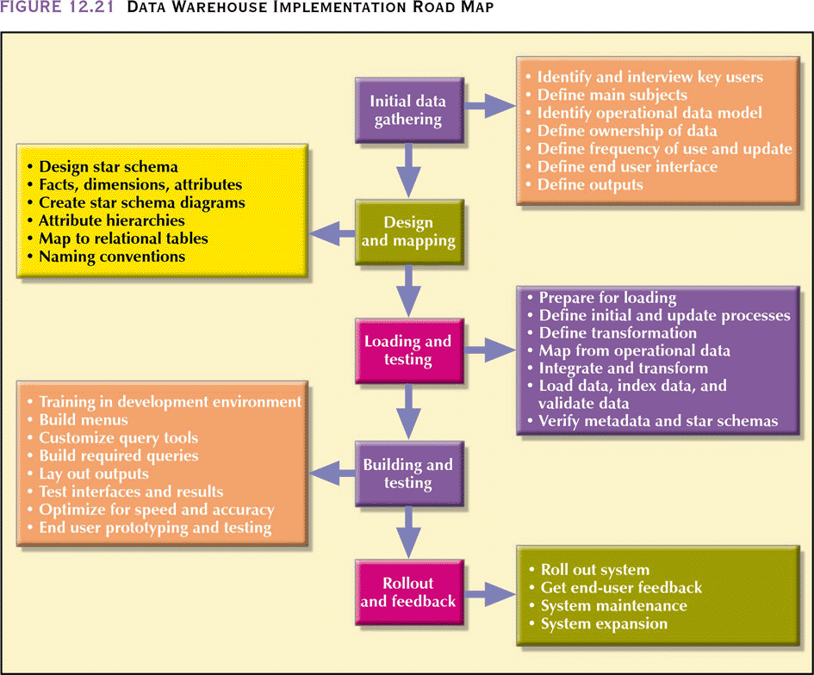
Data Warehouse Implementation
Road Map

Slide 52
Data Mining
Tools that:
  Proactively and automatically search the data
  uncover problems or opportunities hidden in data relationships
  form computer models based on their findings, and then
  use the models to predict business behavior
A methodology designed to perform knowledge discovery expeditions over the database data with only minimal end-user intervention during the discovery phase

Slide 53
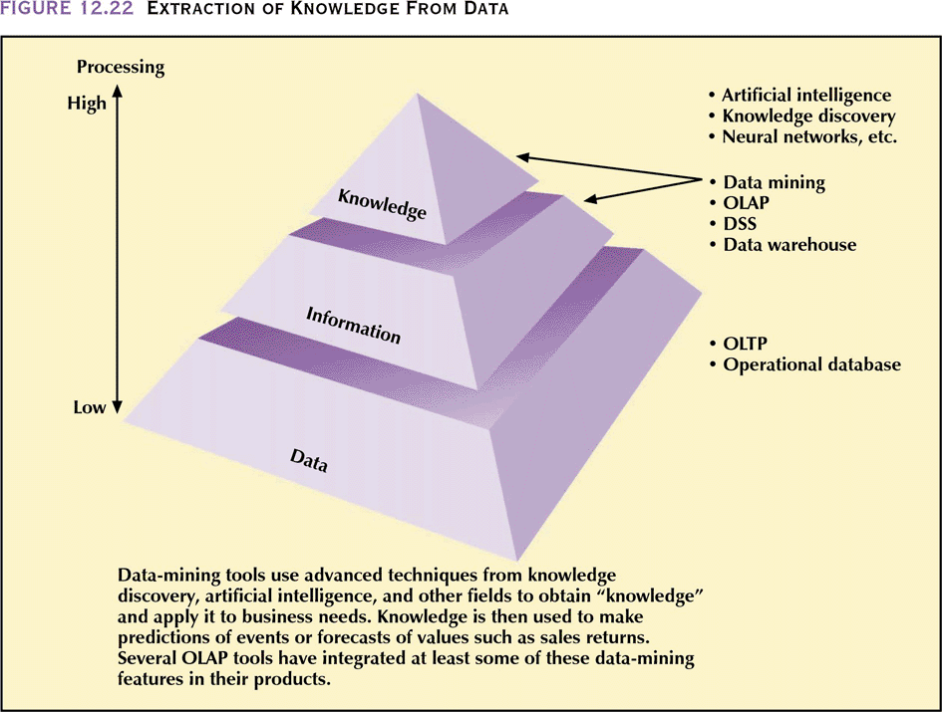
Extraction of Knowledge From Data

Slide 54
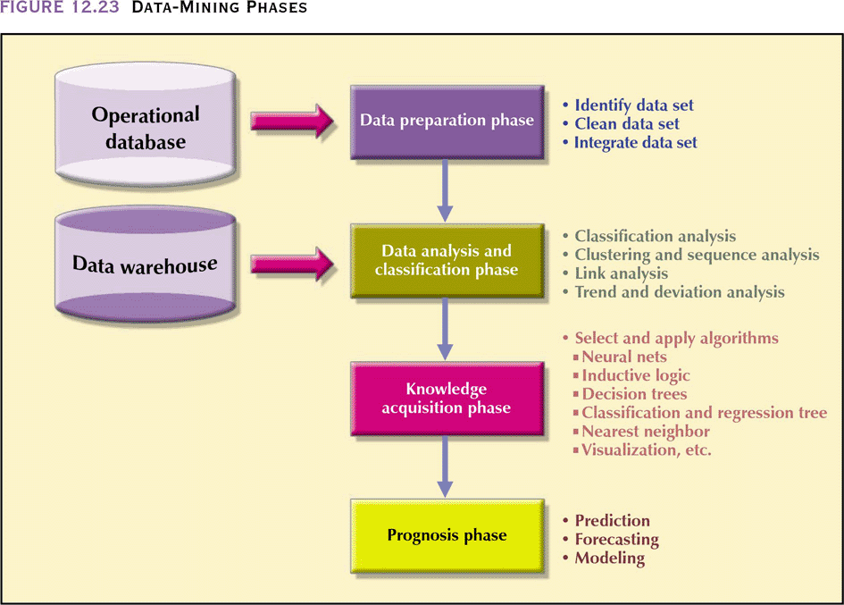
Data-Mining Phases

Slide 55
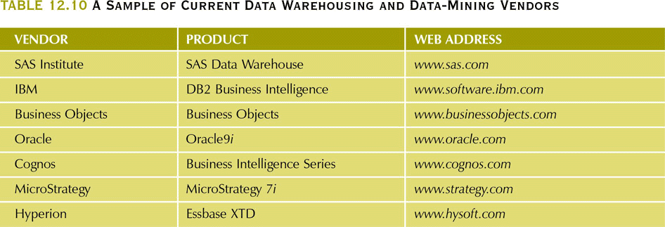
A Sample of Current Data Warehousing and Data-Mining Vendors

